Slide 1
Prediction analysis for house features
This presentation gives an overview of the house features that will help improve sales in the various home agencies

Slide 2
Selected Features
From the dataset provided, we see that most of the houses that are selling well have characteristics of a modern house.
These house have been renovated to fit the client’s interest in various ways. The categorical features of this houses are:
number of bedrooms. Houses with more number of bedrooms were highly valued
Number of bathrooms.Houses with more number of bathrooms were highly vakyed
Square foots for living, lot and basement. The more the square footage, the higher the price of the house
Condition and grade of the house. When the condition and grade of house is higher, the price increase.
Renovations. When a house is renovated, its price increases.

Slide 3
Analysis of the data
To come up with this sekected features, we separated the data to training and test set.
The training set received the instructions of what we want the model to do while the test set gave us a comparison of how good the data has been trained
Below is a comparison of the training and test set

Slide 4
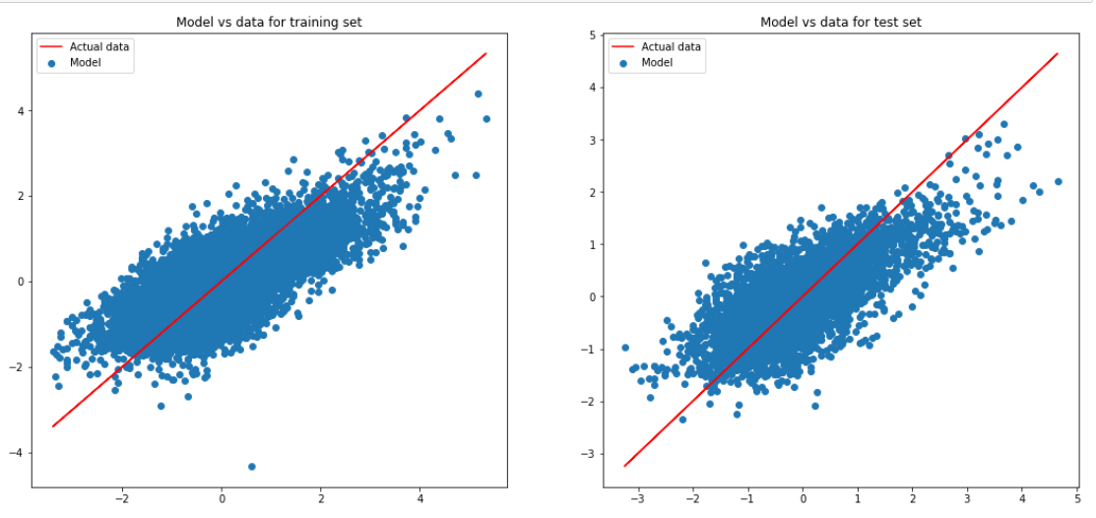
Comparison between Training and test set

Slide 5
The training set and the test have a very small difference. This gives us a clear overview that our model is good and can be used in future for prediction purposes and inferential purposes as well.
After some technical and mathematical calculations, we affirmed that the difference was very small.

Slide 6
Linearity assumption
The model has satisfied he assumprions for linear regression. These assumptions are:
1. There is alinear relationship between the dependent variable and the independent variable
2. There is a normal distribution between the variables
3. The observations are independent of one another
4. There is homoscedasticity in the distributions

Slide 7
Conclusion and Recommendation
For a house to be hugly valued, there are features that contribute to it. These features are:
1. The higher the footage of the home, the higher the price value for the house.
2. The number of bedrooms. Houses with more number of bedrooms were more valued than those with ess
3. The number of floors. Houses with2-3 floors showed a higher price value than those with less
4. The condition. Houses with better living conditions were highly valued.
5. Renovation affects the price of the houses in general

Slide 8
Recommendation
We recommend the agency to emphasize to the home owners to deliver on the features highlighted. This will give them an easier time in selling their homes.

